Slide 1
LOGICAL FALLACIES (1)
Mirko Farina
Assistant Professor
m.farina@innopolis.ru
* I do not claim authorship for all texts and pictures in the presentation.

Slide 2
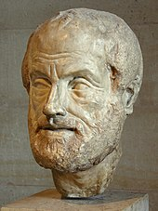
Historical Considerations
The study of logical fallacies really begins with Aristotle. While there was certainly an appreciation of such mistakes in reasoning earlier, Aristotle was the first to begin categorizing them in a systematic way, first under
the title of ‘sophistical refutations’, in a work of that title, and later with a revised list in the Rhetoric

Slide 3

The Sophistical Refutations provides a list of thirteen errors.
To understand what he meant by a ‘sophistical refutation’ we need to appreciate something of the dialectical reasoning that was popular with Aristotle and his contemporaries

Slide 4
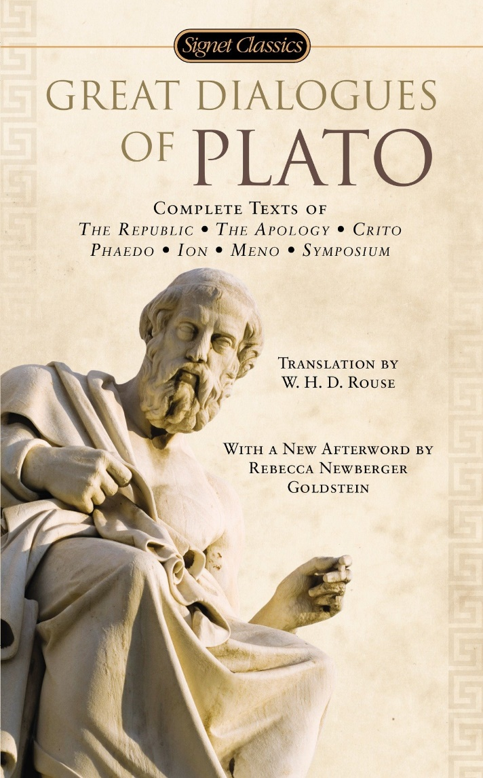
Many of you may be familiar with Socrates’ famous
way of proceeding in Plato’s Dialogues.
In search of some important definition, such as the meaning of ‘courage’ or ‘friendship’, Socrates would seek out alleged experts who could provide the information required and engage them in discussion.
These discussions would have a structure to them whereby a definition or thesis was put forward by the “expert” and Socrates would then ask questions by means of which he gradually demonstrated that the definition failed, or ‘refuted’ the definition

Slide 5
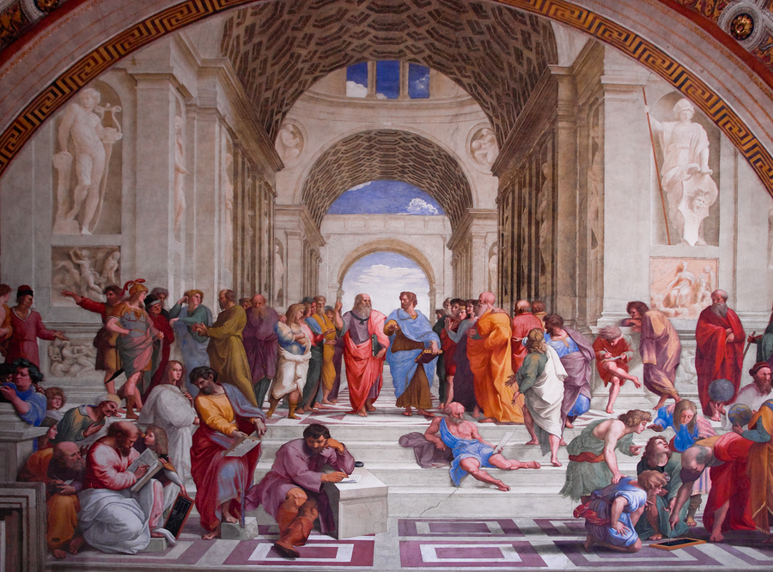
In Plato’s Academy, where Aristotle received his formal training, this model was the basis of a number of structured games or exercises in which one disputant tried to refute the thesis put forward by another.
The inquiry would follow certain accepted patterns and be governed by rules. If the right processes were followed, then any resulting
refutation would be judged a real one.

Slide 6

But Aristotle also recognized
that there could be refutations that appeared real but were
not so.
These he called ‘sophistical’, thereby associating them with the argumentative practices of the Sophists

Slide 7
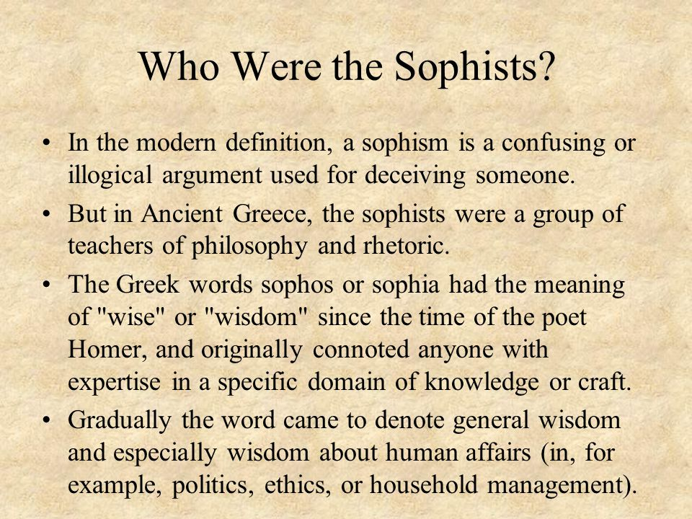
The Sophists were itinerant teachers in fifth-century Greece. Various doctrines and practices are attributed to them, but the picture is less than clear, becauseof our need to rely on the testimonies of Plato and Aristotle (both firm opponents
of the Sophists.
It does seem, though, that
to consider all of their reasoning fallacious would be doing a great injustice to the complexity of their thought

Slide 8
The first six members of the list of thirteen in the Sophistical Refutations belong to his classification of refutations that depend on language:
1. Equivocation, 2. Amphiboly, 3. Combination of Words,
4. Division of Words, 5. Accent, and 6. Form of Expression.

Slide 9
The remaining refutations are placed in a category that does not depend on language:
7. Accident, 8. Secundum quid, 9. Consequent, 10. Noncause, 11. Begging the Question, 12. Ignoratio Elenchi, and 13. Many Questions

Slide 10

To illustrate the treatments of this list, we can take as an example the fallacy of Amphiboly, or “double arrangement.”
As generally interpreted, this fallacy involves an ambiguity arising from the way language is structured. So, a sign in a shop window reading, “Watch repairs here,” would seem to qualify as an amphiboly since it is unclear whether the reader is being invited to leave a watch to be repaired, or to observe repairs taking place; hence, the double
arrangement.

Slide 11

Aristotle’s list in the Rhetoric still retains some of the original thirteen, but since his goals were different in that work, other fallacies are introduced.
In the Rhetoric Aristotle provides nine candidates

Slide 12
A problem may (1) arise from the particular words used; (2) involve an assertion about the whole that is true only of the part, and vice versa; (3) involve the use of indignant language; (4) involve the use of a ‘sign’, or single instance, as certain evidence

Slide 13
(5) Represent the accidental as essential; (6) involve an argument from consequence; (7) involve a false cause; (8) omit mention of time and circumstance; (9) confuse the absolute with the particular.
In this lecture we will see vestiges of some of these fallacies; others have dropped by the wayside.

Slide 14
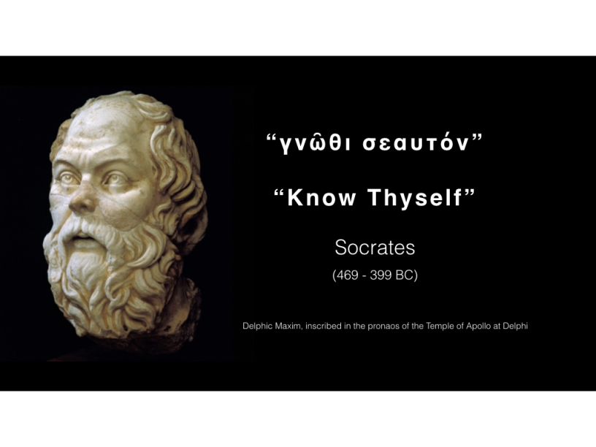
As a tradition of fallacy developed out of the Aristotelian
account, scholars and teachers have struggled to fit Aristotle’s
original fallacies into their own discussions.
In many instances, such attempts were unsuccessful because the nature of Aristotle’s
insight arose from the original (Socratic) context of a dialectical debate.

Slide 15
Outside such a context, the “fallacy” and its description made little sense. Thus, while contemporary accounts retain some of Aristotle’s fallacies, they often take on much different descriptions.
Our understanding of fallacies has simply changed too much for the original, Aristotelian, description to be completely applicable in modern contexts.
Yet, Aristotle’s insights have been instrumental for the development of our modern understanding of fallacies

Slide 16
4 Major Types of Fallacies
Fallacies of Diversion
Fallacies of Structure (some of which we already known from week 4, deduction)
3. Fallacies of Language
4. ‘Ad Arguments’

Slide 17

Fallacies of Diversion
Straw man
2. Red Herring
3. Irrelevant Conclusion

Slide 18
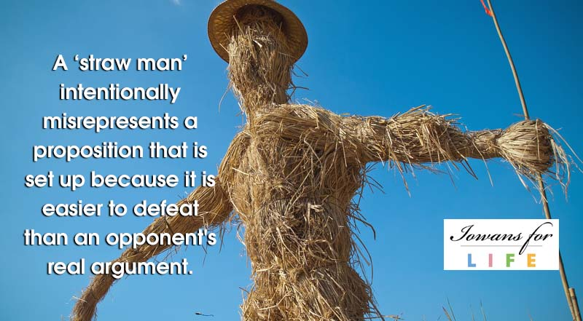
The Straw Man fallacy involves the attribution or assumption of a position, which is then attacked or dismissed.
The problem is that the position dismissed by the argument is not the real ‘man’ or ‘person’, but a caricature of the real position held

Slide 19
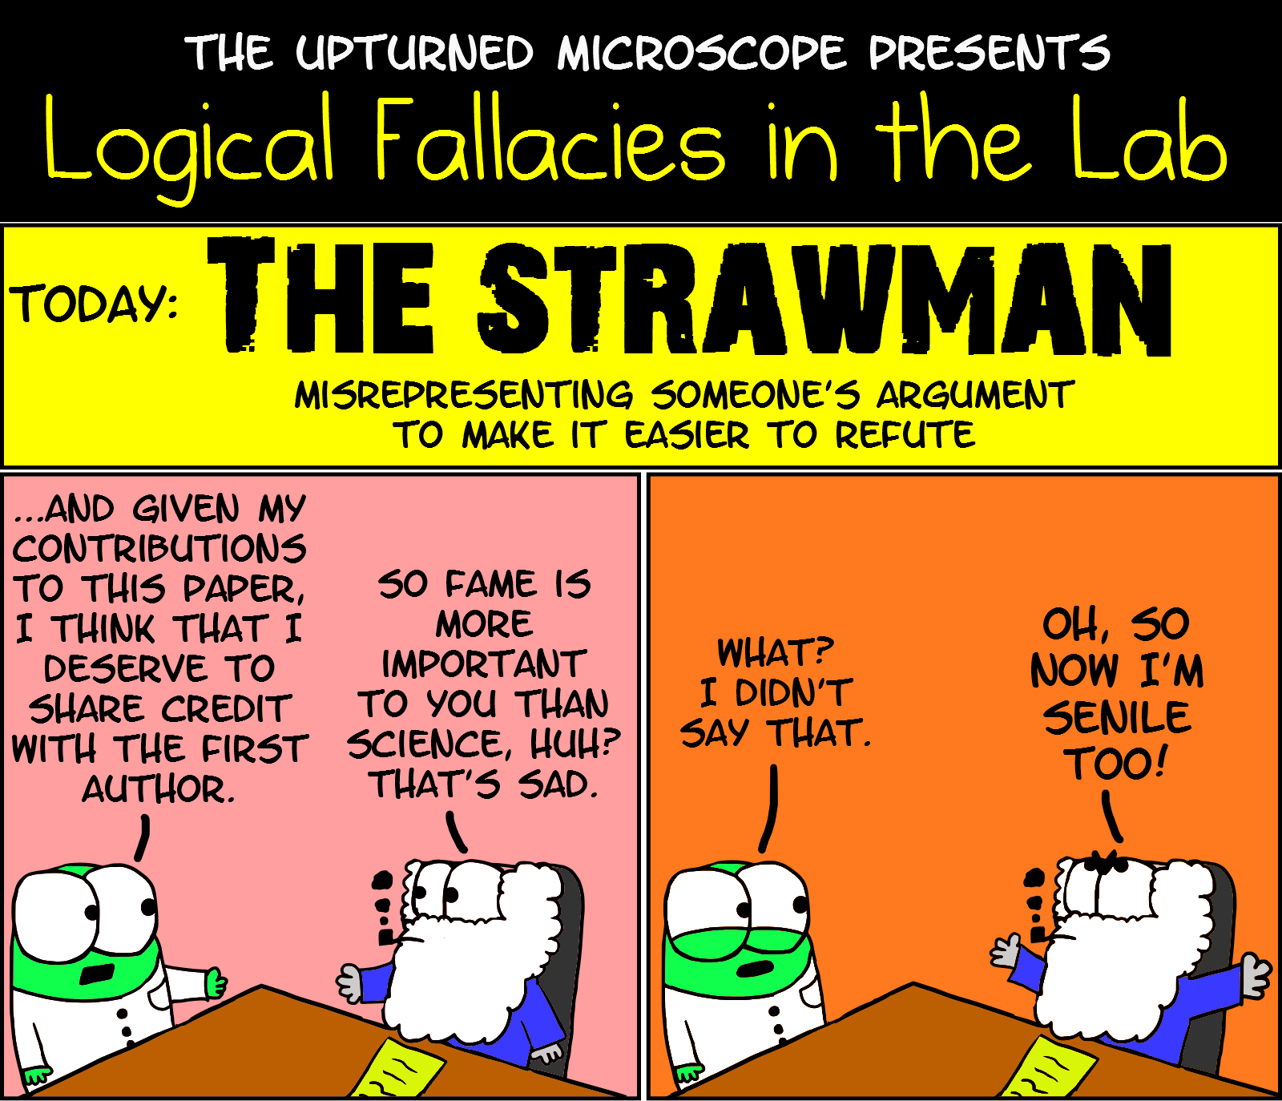
In a dialogue, a position may be explicitly attributed to an opponent. But for whatever reason, either that position is not one that the opponent actually holds, or the opponent does not hold the position in quite the way that has been attributed.
Hence, an argument that attacks and dismisses the attributed position diverts attention from the real position and is therefore fallacious

Slide 20
EXAMPLE 1
Politician A: Why is the government once again moving crime to the top of its agenda when far more pressing issues like childhood poverty and environmental devastation continue to be under addressed?
Politician B: I am surprised that my honorable friend thinks crime is so unimportant. With the alarming increase in gang violence in our cities we face a breakdown of law and order on a major scale. The members of the opposition would wish on us a society in which
people could never feel safe even in their own homes.

Slide 21
Politician A is asking the government representative to justify the government’s choice of crime as the key issue with which it deals.
The rhetorical nature of the question assumes that other issues are more important. But Politician A never states that the issue of crime is unimportant.
The government’s representative, Politician B, counters with just such a misrepresentation of A’s position, attributing that claim to A and proceeding to paint the opposition as a party that does not care about people’s safety. Since safety is a concern, the opposition party’s “position” must be dismissed.

Slide 22
But Politician B has diverted attention from the real question of whether childhood poverty and environmental concerns are more pressing issues and why the government judges crime to be more important.
What has been attacked and dismissed is a position that
we have no reason to believe A actually holds.

Slide 23
EXAMPLE 2 - Draft of a bill in the USA (Louisiana)
Whereas, the writings of Charles Darwin, the father of evolution, promoted the justification of racism, and his books On the Origin of Species by Means of Natural Selection: or the Preservation of Favoured Races in the Struggle for Life and The Descent of Man postulate a hierarchy of superior and inferior races. . . . Therefore, be it resolved that the legislature of Louisiana does hereby deplore all instances and all ideologies of racism, does hereby reject the core concepts of Darwinist ideology that certain races and classes of humans are inherently superior to others, and does hereby condemn the extent to which these philosophies have been used to justify and approve racist practices.

Slide 24
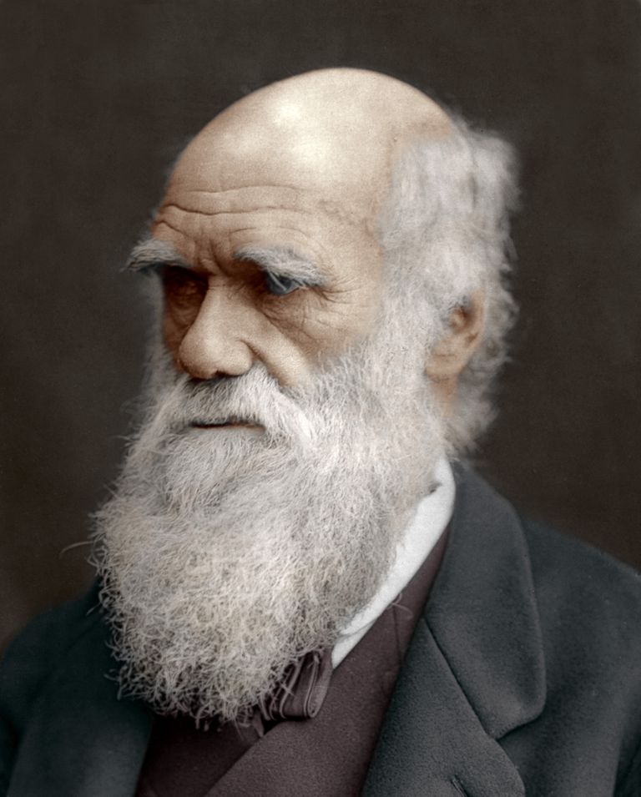
In this case, the proposed bill dismisses Darwinian ideology Because its core concepts hold that certain races and classes of humans are inherently superior to others.
The conclusion and the reason for it are quite clear. If we can imagine the dialogue that is at stake here, the Darwinism proponent is being dismissed because her or his position is racist.

Slide 25

But the portray painted of Darwin’s ideology is a caricature, one not borne out by any objective survey of the works cited.
That similar misrepresentations of Darwinian thinking have been used to justify and approve racist practices is beside the point: the position that the legislation is attacking and dismissing is a Straw Man.
In subsequent debate this error was recognized, and the eventual bill omitted all mention of Darwin and Darwinist ideology.

Slide 26

In good dialectical exchanges, arguers are also encouraged to consider the strongest point of their opponent’s position and try to address that.
Deliberately distorting a position by conjuring up a weak caricature of it is not fulfilling that obligation; nor does it do the arguer’s own position a lot of good if the strategy is detected

Slide 27
But the fallacy does not lie in the intent of the arguer to deceive.
Straw Man reasoning can arise accidentally as well as deliberately, even if we may tend to give more notice to the intentional strategy. In 1, for example, the misrepresentation would seem to be intentional.
Politicians, or individuals in similar kinds of antagonistic relationships that have a certain structure, may come to learn and adopt this strategy of misrepresentation as a matter of course.

Slide 28

But one can also misrepresent accidentally, as may have happened in Case 2. Given that some racist ideology has adopted Darwinian concepts in the past, distorting them to its own ends, we can understand how people concerned about racism could make incorrect assumptions about Darwin’s work if they had not reviewed that work themselves

Slide 29
How to Treat Straw Man?
Argumentation theorists advise us to avoid debating the distorted version of the position and to check the accuracy of all statements used, and this is good advice

Slide 30

2. Red Herring
In foxhunting, once the hounds have scent of a fox nothing will deter them from their course except a more powerful scent drawn across the path to lead them off in another direction.
A pungent smoked (or red) herring has just such a scent, and these can be used for various reasons to call off a hunt. This metaphor of distraction has been adopted in argumentation to name the fallacy of diverting attention to a new issue so that the other party or audience will completely lose the scent of the original issue

Slide 31
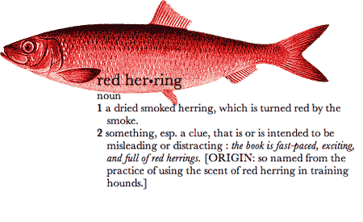
Unlike the Straw Man fallacy, a Red Herring does not involve any misrepresentation of an opponent’s position.
it is the introduction of another issue altogether, which is not related to the real issue under debate

Slide 32
EXAMPLE 1
Many of your readers seem devastated by the callousness of the annual seal hunt and the culling of seal pups, but their concern is misapplied when they so blithely overlook the real crime being perpetrated every year in this country in the slaughter of thousands of the unborn. Abortion accounts for more deaths of innocents than many wars, but still society does nothing

Slide 33
The quick response to this may be to allow that they are two very serious issues, but ask how exactly the second is related to the first.
The imagined writer is responding to a debate that has obviously developed in the publication’s pages over the hunting of seals for their pups. Many people find this offensive and unnecessary.
But the writer shifts the focus to a separate issue altogether, one that is not obviously relevant to the first and does not move the discussion back to address the first issue in any way that would contribute to that debate.

Slide 34

The difficulty suggests itself, though, in that the writer may well see some connection between the two issues: these are both matters for concern; both issues involve the deaths of ‘innocents’.
So our judgments regarding the committing of Red Herrings must always involve some consideration of whether there is sufficient relevance of the issues to each other to justify the shift.

Slide 35
EXAMPLE 2
Invasion of Iraq – British Parliament
Politician A: Which Iraqi opposition groups favour
the intense bombing likely to be conducted by the Americans to minimize the number of body bags that will be taken back to Alabama or Wyoming?

Slide 36
Politician 2: The Iraqi opposition groups want the removal of Saddam Hussein. If there were a choice between a peaceful and democratic regime in Iraq under Saddam Hussein and a war, the issue might be different, but the fact is that Saddam Hussein has carried out the
wholesale slaughter of large numbers of his people. I urge my hon. Friend to remember the 5,000 men, women and children who died at Halabja in 1988 and the 9,000 who were injured there. We need to make sure that Saddam Hussein is recognised as the tyrant that he is, and is dealt with accordingly

Slide 37
Politician A’s question still demands an answer
on whether any Iraqi opposition groups favour intense bombing.
Politician B’s response does not address that point at all. Instead, he shifts the focus within the general topic to the crimes of Hussein’s regime and the Iraqi opposition’s desire to remove that regime.
While related to the topic, the response is not strictly relevant to the question raised and so can be seen to divert attention to ground that is easier to address. In so doing Politician B offers a Red Herring.

Slide 38

The key thing that has gone wrong in these examples is that the arguer has shifted the issue to another issue or another aspect of the same issue the fallacy lies in the irrelevance of the shift insofar as the initial issue or point is not returned to or addressed

Slide 39
How to Treat Red Herring? Tips (Ask yourself the following questions)
1. Has the issue been shifted in the course of an argument to another issue or different aspect of the same issue and not shifted back?
2. Is the shift irrelevant to addressing the initial issue?

Slide 40
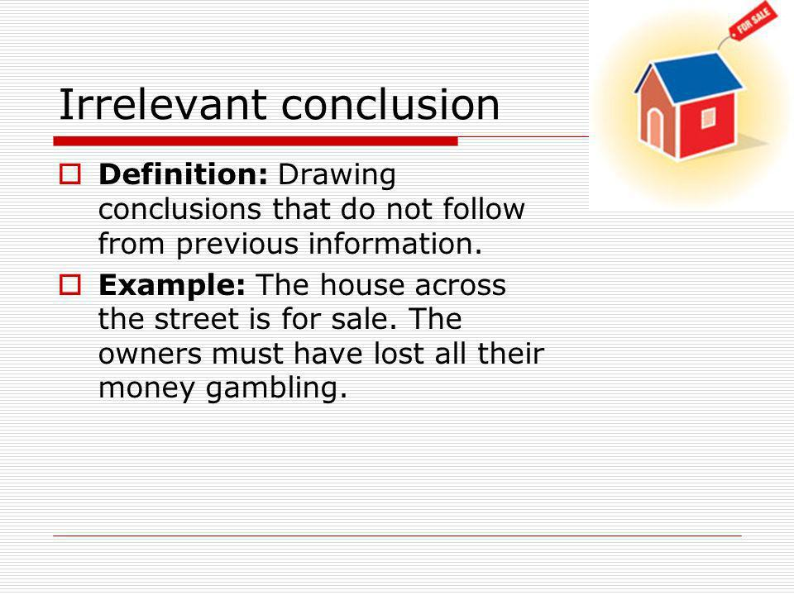
3. Irrelevant Conclusion
Crucial Idea = the argument, the conclusion does not follow from the premise.

Slide 41
EXAMPLE 1
There are more Elvis impersonators in the state of California than students at this institution. Therefore, there is no reason to be concerned about the rise in student numbers.

Slide 42
Quite simply, in this imagined case there seems no obvious connection between what is said in the premise (the first statement) and what is concluded from it, as shown by the ‘therefore’.
What is important to note is that even if there are more Elvis impersonators in the state of California, that makes no difference to our reasons for believing the conclusion stated. What this means is that the truth or acceptability of a premise is a property quite separate from its relevance in a particular context.

Slide 43
EXAMPLE 2
Retaining Canadian Control over a company, the Hudson’s Bay Company, which was about to be sold to an American company
Many people thought that because of its historical significance, the company should be protected or remain under Canadian control. In response to this concern one correspondent argued(Globe and Mail, August 17, 2004)
Recent letter writers have expressed a great deal of fondness for the historical exploits of Hudson’s Bay Co. This company was primarily responsible for manipulating and oppressing the native people, slaughtering millions of helpless animals in the name of fashion and generally being a greed-driven, me-first, ecologically uncaring corporation that worshipped the almighty dollar above all else.

Slide 44

First, we need to assure ourselves that the writer is intending to issue an argument.
This may be a case in which the best course is to invoke the Principle of Charity and judge this as an opinion

Slide 45

But that seems inappropriate here because we have a clear disagreement with a point of view that has been previously expressed by others.
That point of view was the fondness felt for the historical traditions of the Hudson’s Bay Company, given as a reason for retaining it as a Canadian institution. This writer disagrees with that conclusion. So, we do have an argument here

Slide 46
Next, we need to evaluate the relevance of the reasons given to the claim that the Hudson’s Bay Company should not be retained.
Are the past “crimes” recounted here relevant to the decision of whether to retain the company under Canadian control?
Assuming that the writer considers the points to be relevant, we need to consider carefully whether there are connections between past misdemeanors and the value of retaining the institution.
This example illustrates once again that we must evaluate each case on its own merit and not use fallacy assessment as a simple matter of applying labels and dismissing arguments

Slide 47
FUTHER READINGS
The Straw Man Fallacy” in Logic and Argumentation, edited by Johan van Benthem, et al. (Amsterdam: Royal Netherlands Academy of Arts & Sciences, 1996), pp. 115–128.
Douglas Walton’s A Pragmatic Theory of Fallacy
(Tuscaloosa: University of Alabama Press, 1995),

Slide 48
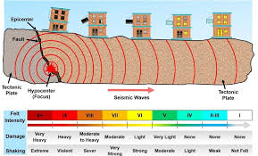
Fallacies of Structure
These fallacies concern the structure or form of an argument
Here, the argument is presented as if the conclusion must follow, given the truth of the premises. But in fact, because of the way terms or propositions within the argument have been organized, the conclusion does not follow from the premises
Among fallacies of structure there are denying the antecedent and affirming the consequent (which we already reviewed in week 4

Slide 49

But there are more such as the fallacy of distribution
What does Distribution mean?
A term is said to be ‘distributed’ in a proposition when it is meant to refer to all members of the class of things that proposition denotes

Slide 50
To understand this sort of fallacy we can refer to a set of 3 rules which were formulated by Hamblin (p. 199). Violating any of these rules generate a structural fallacy
1. The middle term must be distributed at least once.
2. No term must be distributed in the conclusion that was not distributed in the premise in which it arose.
3. There can only be one negative premise, and if there is, there must also be a negative conclusion

Slide 51

EXAMPLE 1 (violates 1)
All people with conservative values support the war. Some religious leaders support the war. So, some religious leaders must have conservative values. We can see that this argument meets the conditions of having three propositions, two premises and a conclusion, and three terms, ‘people with conservative values’, ‘supporters of the war’, and ‘religious leaders’.
Thus identified, the argument can be set out as follows:

Slide 52

Premise: All people with conservative values are supporters of the war.
Premise: Some religious leaders are supporters of the war.
Conclusion: Some religious leaders are people with conservative values

Slide 53
Rule 1 tells us the middle term must be distributed at least once.
The middle term in a syllogism is the term that the two premises have in common. In this case, the middle term is ‘supporters of the war’. A valid syllogism shows the relationship of two terms in the conclusion by virtue of the relationship each has with a ‘middle’ term in the two premises.
If the middle term is not distributed at least once, such that the entire class is referred to, then it is possible that the other terms are being related to a different portion of the
middle term, in which case no conclusion can be drawn about the relationship between those other two terms

Slide 54
The argument we are evaluating has the following Distribution pattern:
Premise: All people with conservative values (distributed) are supporters of the war (undistributed).
Premise: Some religious leaders (undistributed) are supporters of the war (undistributed).
Conclusion: Some religious leaders (undistributed) are people with conservative values (undistributed).

Slide 55
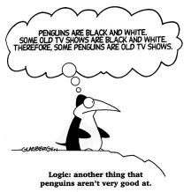
The middle term, ‘supporters of the war’, is undistributed in both premises, so this argument has an invalid structure. We can say it commits the Fallacy of the Undistributed Middle

Slide 56
The second rule can be violated when either of the terms in the conclusion is distributed but had not been distributed in the premise in which it arose.
This is means that the conclusion contains more information than the premises warrant, or, put another way, we are drawing a conclusion about all of a class denoted by the term based on information about only a portion of that class.

Slide 57

EXAMPLE 2
All Westerners are overconsumers.
But no Japanese are Westerners.
Therefore, no Japanese are overconsumers

Slide 58
Again, we have three propositions and three terms or classes of things. This argument can be set out to show the following Distribution pattern:
Premise: All Westerners (distributed) are overconsumers
(undistributed).
Premise: No Japanese (distributed) are Westerners (distributed).
Conclusion: No Japanese (distributed) are overconsumers (distributed).

Slide 59
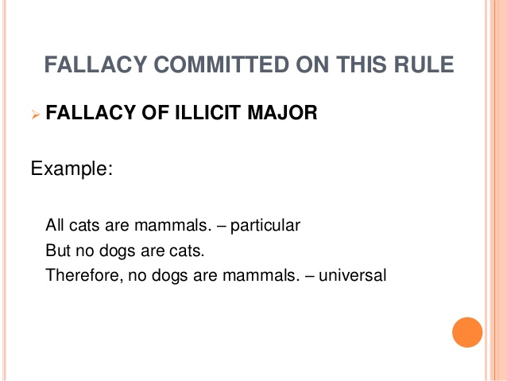
We have two terms in the conclusion, ‘Japanese’ and ‘overconsumers’. The first of these is distributed in both the conclusion and the second premise.
But ‘overconsumers’ is distributed in the conclusion but not in the first premise. Since this is called the major premise, the term in it besides the middle term is called the major term.
The fallacy we have identified here is the Fallacy of the Illicit Major.

Slide 60
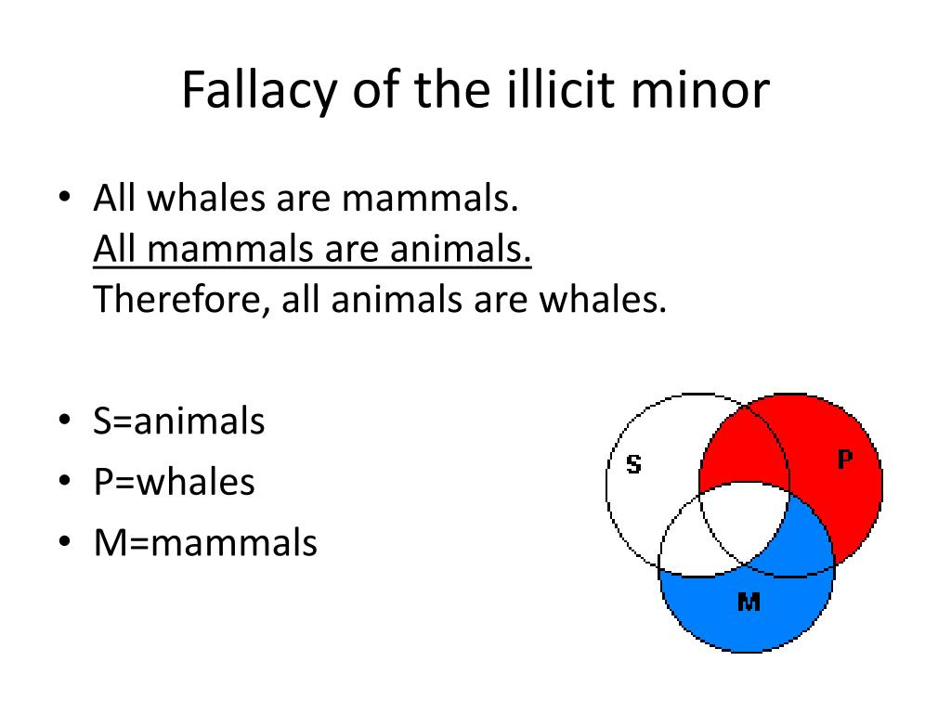
If the same problem had been with the term in the second, minor, premise and the conclusion, then we would have a Fallacy of the Illicit Minor

Slide 61
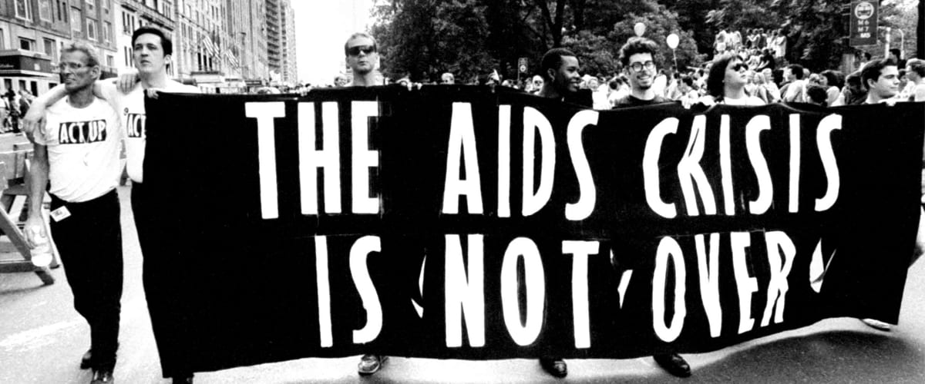
EXAMPLE 3
No Third World countries are free from the AIDS epidemic. And not all Third World countries have economies that can afford the cost of drugs needed to fight the AIDS epidemic. So, not all Third World countries that have economies that can afford the cost of drugs needed
to fight the AIDS epidemic are free from the AIDS epidemic

Slide 62
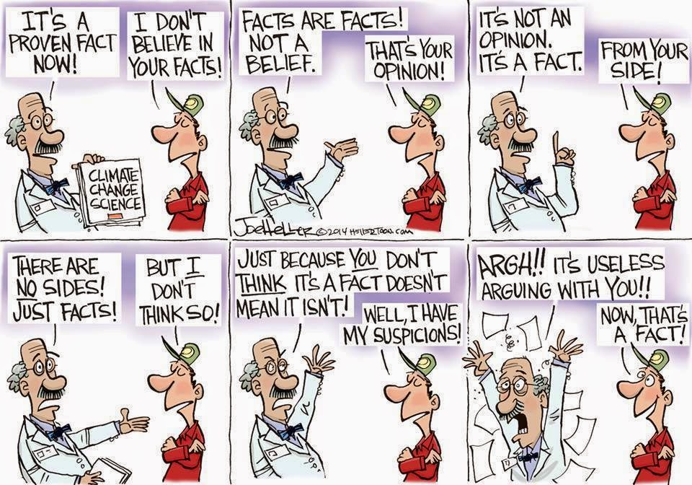
The problem with this argument is that each of the propositions excludes classes from each other. On this basis, no conclusion can be drawn about any relationship between the classes.
The fallacy described here is called the Fallacy of Negativity

Slide 63
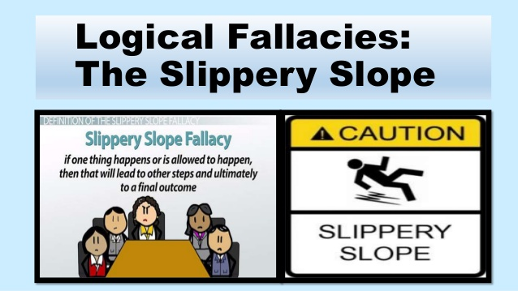
Slippery Slope (a fallacy of correlation)
Slippery Slope reasoning is a type of negative reasoning from consequences, distinguished by the presence of a causal chain leading from the proposed action to the negative outcome.
In its most straightforward form, the argument includes a crucial premise in which it is maintained that the proposed action will (or probably will) lead to a series of causally connected actions

Slide 64

The debates in several Western nations over the merits of same-sex marriage (and the subsequent enabling legislation in some) have led to a range of arguments opposing such an idea on the basis of the likely consequences. The following is a brief extract from one such discussion, accessed May 23, 2004,
http://www.family.org/cforum/extras/a0032427.cfm:

Slide 65

‘First, when the State sanctions homosexual relationships and gives them its blessing, the younger generation becomes confused about sexual identity and quickly loses its understanding of lifelong commitments, emotional bonding, sexual purity, the role of children in a family, and from a spiritual perspective, the “sanctity” of marriage

Slide 66
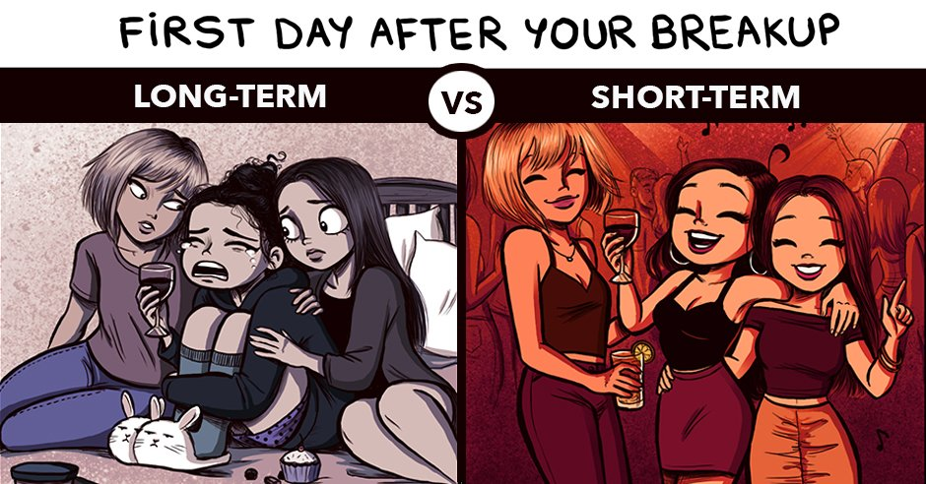
…Marriage is reduced to something of a partnership that provides attractive benefits and sexual convenience, but cannot offer the intimacy described in Genesis. Cohabitation and short-term relationships are the inevitable result. Ask the Norwegians, the Swedes, and the people from the Netherlands. That is exactly what is happening there’.

Slide 67
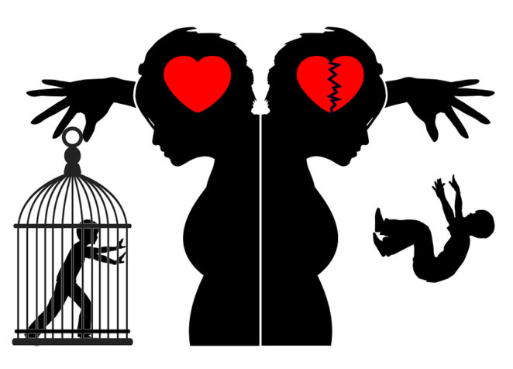
As in many Slippery Slope arguments, the conclusion in this one is implicit:
we do not want the final consequence in the series (cohabitation and short-term relationships) to occur and so we should not take the first step, which is to allow the state to sanction same-sex relationships/marriages

Slide 68

The core premise in the argument is the causal premise, which presents two links.
As a first causal step, the younger generation will become “confused about sexual identity” and lose its understanding of a range of things related to relationships.
This in turn will lead (inevitably) to the second step of cohabitation and short-term relationships

Slide 69
Good Slippery Slope arguments will present causal links that are plausible (while not guaranteed) and a consequence that is clearly negative.
The argument here does neither.
We have no obvious reason to think that legislation to permit one segment of society to marry will cause a whole generation to become confused about their sexual identity (for some, it could have the opposite effect). Nor would we expect that generation “quickly” to lose its understanding of life-long relationships. If anything, it would witness an expanded range of such examples.

Slide 70
The next step to cohabitation and short-term relationships is also not obvious. While an increase in cohabitation might well occur in coming decades, the factors influencing that may already be in place,
since we currently see such a trend in some societies, so linking this to state sanctioning of homosexual relationships requires considerable argumentation that is not present

Slide 71

In effect, the arguer is implying that the proposal would lead to the end of traditional marriage even in heterosexual communities, and that is a jump unwarranted by anything provided here.

Slide 72
Finally, the negative factor concerns the undesirability of the consequence.
Arguably, the immediate audience for this argument would find widespread cohabitation and short-term relationships, rather than traditional marriages, undesirable. But the larger audience that would be affected by such a change in social policy may not see this as undesirable.
In sum, we have grounds for judging this argument to be fallacious, and the fallacy in question is that of the Slippery Slope

Slide 73


